Slide 1

CS 61C: Great Ideas in Computer Architecture Lecture 9: Synchronous Digital Systems
Instructor: Sagar Karandikar
sagark@eecs.berkeley.edu
http://inst.eecs.berkeley.edu/~cs61c

Slide 2


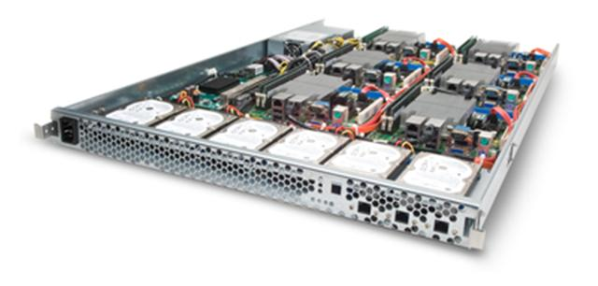
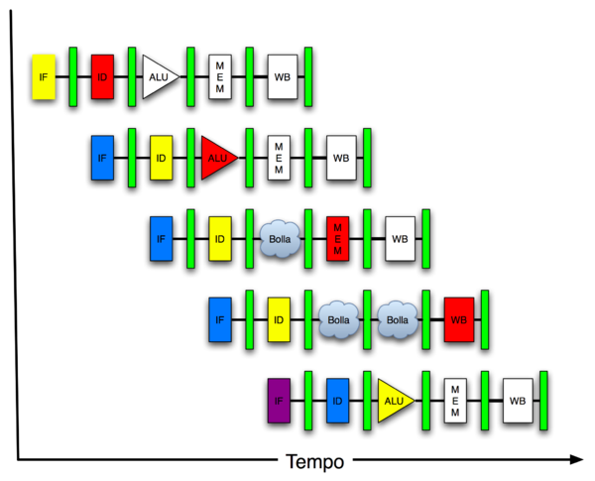
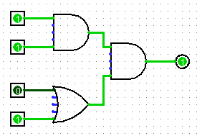
You are Here!
Software Hardware
Parallel Requests
Assigned to computer
e.g., Search “Katz”
Parallel Threads
Assigned to core
e.g., Lookup, Ads
Parallel Instructions
>1 instruction @ one time
e.g., 5 pipelined instructions
Parallel Data
>1 data item @ one time
e.g., Add of 4 pairs of words
Hardware descriptions
All gates @ one time
Programming Languages
Warehouse Scale Computer
Smart Phone
Harness Parallelism &
Achieve High Performance
Computer
Core
…
Core
Memory (Cache)
Input/Output
Core
Instruction Unit(s)
Functional
Unit(s)
A₀+B₀
A₁+B₁
A₂+B₂
A₃+B₃
Cache Memory
Today
Logic Gates

Slide 3
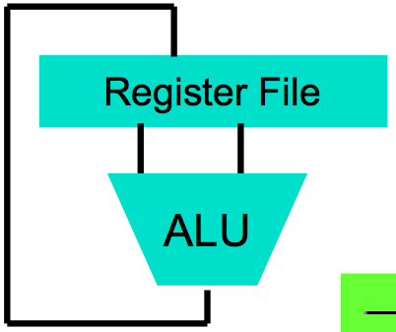
Levels of Representation/Interpretation
High Level Language Program (e.g., C)
temp = v[k];
v[k] = v[k+1];
v[k+1] = temp;
Compiler
Anything can be represented as a number, i.e., data or instructions
lw $t0, 0($2)
lw $t1, 4($2)
sw $t1, 0($2)
sw $t0, 4($2)
Assembly Language Program (e.g., MIPS)
Assembler
0000 1001 1100 0110 1010 1111 0101 1000
1010 1111 0101 1000 0000 1001 1100 0110
1100 0110 1010 1111 0101 1000 0000 1001
0101 1000 0000 1001 1100 0110 1010 1111
Machine Language Program (MIPS)
Machine Interpretation
Hardware Architecture Description (e.g., block diagrams)
Architecture Implementation
Logic Circuit Description (Circuit Schematic Diagrams)

Slide 4
Hardware Design
Next several weeks: how a modern processor is built, starting with basic elements as building blocks
Why study hardware design?
Understand capabilities and limitations of HW in general and processors in particular
What processors can do fast and what they can’t do fast (avoid slow things if you want your code to run fast!)
Background for more in-depth HW courses (CS 150, CS 152)
Hard to know what you’ll need for next 30 years
There is only so much you can do with standard processors: you may need to design own custom HW for extra performance
Even some commercial processors today have customizable hardware!

Slide 5
Synchronous Digital Systems
Hardware of a processor, such as the MIPS, is an example of a Synchronous Digital System
Synchronous:
All operations coordinated by a central clock
“Heartbeat” of the system!
Digital:
Represent all values by discrete values
Two binary digits: 1 and 0
Electrical signals are treated as 1’s and 0’s
1 and 0 are complements of each other
High /low voltage for true / false, 1 / 0

Slide 6
Switches: Basic Element of Physical Implementations
Implementing a simple circuit (arrow shows action if wire changes to “1” or is asserted):
A
Z
Close switch (if A is “1” or asserted) and turn on light bulb (Z)
Z
A
Open switch (if A is “0” or unasserted) and turn off light bulb (Z)
Z ≡ A

Slide 7
Switches (cont’d)
Compose switches into more complex ones (Boolean functions):
A
B
AND
Z ≡ A and B
A
OR
Z ≡ A or B
B

Slide 8
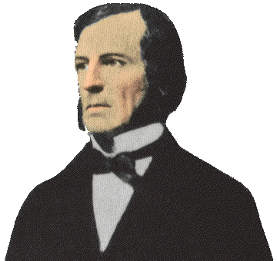
Historical Note
Early computer designers built ad hoc circuits from switches
Began to notice common patterns in their work: ANDs, ORs, …
Master’s thesis (by Claude Shannon) made link between work and 19th Century Mathematician George Boole
Called it “Boolean” in his honor
Could apply math to give theory to hardware design, minimization, …

Slide 9
Transistors
High voltage (V_{dd}) represents 1, or true
In modern microprocessors, Vdd ~ 1.0 Volt
Low voltage (0 Volt or Ground) represents 0, or false
Pick a midpoint voltage to decide if a 0 or a 1
Voltage greater than midpoint = 1
Voltage less than midpoint = 0
This removes noise as signals propagate – a big advantage of digital systems over analog systems
If one switch can control another switch, we can build a computer!
Our switches: CMOS transistors

Slide 10
CMOS Transistor Networks
Modern digital systems designed in CMOS
MOS: Metal-Oxide on Semiconductor
C for complementary: use pairs of normally-open and normally-closed switches
Used to be called COS-MOS for complementary-symmetry -MOS
CMOS transistors act as voltage-controlled switches
Similar, though easier to work with, than electro-mechanical relay switches from earlier era
Use energy primarily when switching
Notes:
Wikipedia: The phrase "metal–oxide–semiconductor" is a reference to the physical structure of certain field-effect transistors, having a metal gate electrode placed on top of an oxide insulator, which in turn is on top of a semiconductor material.
CMOS circuits use a combination of p-type and n-type metal–oxide–semiconductor field-effect transistors (MOSFETs)

Slide 11
CMOS Transistors
Gate
Source
Drain
Three terminals: source, gate, and drain
Switch action: if voltage on gate terminal is (some amount) higher/lower than source terminal then conducting path established between drain and source terminals (switch is closed)
Note circle symbol to indicate “NOT” or “complement”
Gate
Gate
Source
Drain
Source
Drain
n-channel transitor open when voltage at Gate is low closes when:
voltage(Gate) > voltage (Threshold)
(High resistance when gate voltage Low,
Low resistance when gate voltage High)
p-channel transistor closed when voltage at Gate is low opens when:
voltage(Gate) > voltage (Threshold)
(Low resistance when gate voltage Low,
High resistance when gate voltage High)
Notes:
From wikipedia:
The field-effect transistor (FET) relies on an electric field to control the shape and hence the conductivity of a channel of one type of charge carrier in a semiconductor material.
The most commonly used FET is the MOSFET. The CMOS (complementary-symmetry metal oxide semiconductor) process technology is the basis for modern digital integrated circuits. This process technology uses an arrangement where the (usually "enhancement-mode") p-channel MOSFET and n-channel MOSFET are connected in series such that when one is on, the other is off.
CMOS circuits are constructed in such a way that all PMOS transistors must have either an input from the voltage source or from another PMOS transistor. Similarly, all NMOS transistors must have either an input from ground or from another NMOS transistor. The composition of a PMOS transistor creates low resistance between its source and drain contacts when a low gate voltage is applied and high resistance when a high gate voltage is applied.
On the other hand, the composition of an NMOS transistor creates high resistance between source and drain when a low gate voltage is applied and low resistance when a high gate voltage is applied.

Slide 12
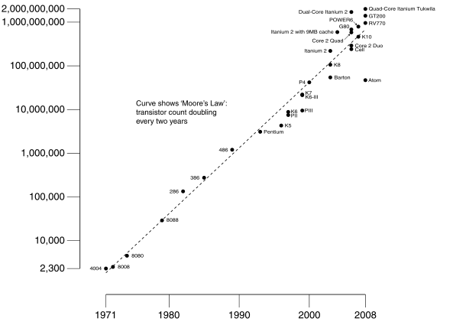

#2: Moore’s Law
Predicts:
2X Transistors / chip every 2 years
# of transistors on an integrated circuit (IC)
Modern microprocessor chips include several billion transistors
Gordon Moore Intel Cofounder B.S. Cal 1950!
Year

Slide 13
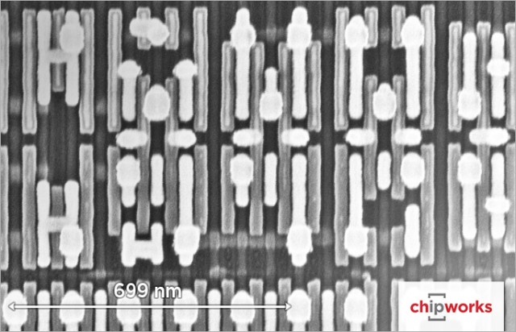
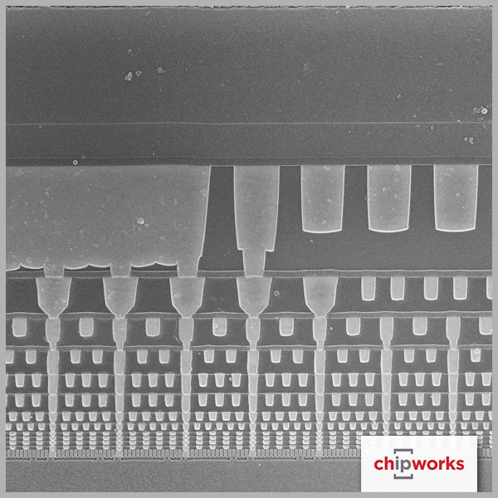
Intel 14nm Technology
Plan view of transistors
Side view of wiring layers

Slide 14
Scale of the Universe
http://htwins.net/scale2/

Slide 15
CMOS Circuit Rules
Don’t pass weak values => Use Complementary Pairs
N-type transistors pass weak 1’s (V_{dd} - V_{th})
N-type transistors pass strong 0’s (ground)
Use N-type transistors only to pass 0’s (N for negative)
Converse for P-type transistors: Pass weak 0s, strong 1s
Pass weak 0’s (V_{th}), strong 1’s (V_{dd})
Use P-type transistors only to pass 1’s (P for positive)
Use pairs of N-type and P-type to get strong values
Never leave a wire undriven
Make sure there’s always a path to V_{dd} or GND
Never create a path from V_{dd} to GND (ground)
This would short-circuit the power supply!
Notes:
Wikipedia: CMOS accomplishes current reduction by complementing every nMOSFET with a pMOSFET and connecting both gates and both drains together. A high voltage on the gates will cause the nMOSFET to conduct and the pMOSFET not to conduct while a low voltage on the gates causes the reverse. This arrangement greatly reduces power consumption and heat generation. However, during the switching time both MOSFETs conduct briefly as the gate voltage goes from one state to another. This induces a brief spike in power consumption and becomes a serious issue at high frequencies.

Slide 16
CMOS Networks
p-channel transistor closed when voltage at Gate is low opens when:
voltage(Gate) > voltage (Threshold)
X
what is the relationship between x and y?
1V
x
y
Y
0 Volt
(GND)
1 Volt (Vdd)
0V
1 Volt
(Vdd)
0 Volt (GND)
n-channel transitor open when voltage at Gate is low closes when:
voltage(Gate) > voltage (Threshold)
Called an inverter or not gate
Notes:
X = 0 implies top switch is closed, so 3V sent Y
X = 0 implies bottom switch is open, so nothing sent to Y
X = 3v implies Top switch is open, so nothing sent to Y
X = 3v implies Bottom switch is closed, so 0V sent Y
Wikipedia:
The image shows what happens when an input is connected to both a PMOS transistor (top of diagram) and an NMOS transistor (bottom of diagram). When the voltage of input X is low, the NMOS transistor's channel is in a high resistance state. This limits the current that can flow from Y to ground.
The PMOS transistor's channel is in a low resistance state and much more current can flow from the supply to the output. Because the resistance between the supply voltage and Y is low, the voltage drop between the supply voltage and Y due to a current drawn from Y is small. The output therefore registers a high voltage.
On the other hand, when the voltage of input X is high, the PMOS transistor is in an OFF (high resistance) state so it would limit the current flowing from the positive supply to the output, while the NMOS transistor is in an ON (low resistance) state, allowing the output to drain to ground.
Because the resistance between Y and ground is low, the voltage drop due to a current drawn into Y placing Y above ground is small. This low drop results in the output registering a low voltage.
In short, the outputs of the PMOS and NMOS transistors are complementary such that when the input is low, the output is high, and when the input is high, the output is low. Because of this behavour of input and output, the CMOS circuits' output is the inverse of the input.

Slide 17
Two-Input Networks
what is the relationship between x, y and z?
X
Y
x
y
z
1V
0 Volt
1 Volt
0 Volt
0 Volt
1 Volt
1 Volt
Z
1 Volt
1 Volt
0 Volt
0V
1 Volt
1 Volt
0 Volt
Called a NAND gate (NOT AND)
Notes:
Top
X = 0v Y = 0V both closed on top, so Z = 3v
X = 0v Y = 0V both open bottom
X = 0v Y = 3V 2nd closed on top, so Z = 3v
X = 0v Y = 3V 2nd in series open
X = 3v Y = 0V 1st closed on top, so Z = 3v
X = 3v Y = 0V 1st in series open
X = 3v Y = 3V both open on top
X = 3v Y = 0V both closed, so Z = 0v

Slide 18
Clickers/Peer Instruction
X
Y
x
y
z
A B C D
1V
0 Volt
0 Volt
0 0 1 1
Volts
0 Volt
1 Volt
0 1 0 1
Volts
Z
1 Volt
0 Volt
0 1 0 1
Volts
1 Volt
1 Volt
1 1 0 0
Volts
0v
Notes:
Top
X = 0v Y = 0V both closed on top, so Z = 3v
X = 0v Y = 0V both open bottom
X = 0v Y = 3V 2nd closed on top, so Z = 3v
X = 0v Y = 3V 2nd in series open
X = 3v Y = 0V 1st closed on top, so Z = 3v
X = 3v Y = 0V 1st in series open
X = 3v Y = 3V both open on top
X = 3v Y = 0V both closed, so Z = 0v

Slide 19
Administrivia
HW2 out
We recommend doing this before the midterm
Proj 2-1 out
Make sure you test your code on hive machines, that’s where we’ll grade them
Team registration problems? Email Jay

Slide 20
Administrivia
Midterm this Thursday
In this room, at this time
One 8.5”x11” handwritten cheatsheet
We’ll provide a MIPS green sheet
No electronics
Covers up to and including last lecture (07/02)
TA-led review session tonight (07/06) from 5-8pm in HP Auditorium

Slide 21
Break

Slide 22






Combinational Logic Symbols
Common combinational logic systems have standard symbols called logic gates
Buffer, NOT
AND, NAND
OR, NOR
A
Z
A
Z
B
Inverting versions (NOT, NAND, NOR) easiest to implement with CMOS transistors (the switches we have available and use most)
A
Z
B

Slide 23
Representations of Combinational Logic (groups of logic gates)
Truth Table
Enumerate Inputs
Enumerate Inputs
Sum of Products,
Product of Sums Methods
Boolean Expression
Use Equivalency between boolean operators and gates
Gate Diagram

Slide 24
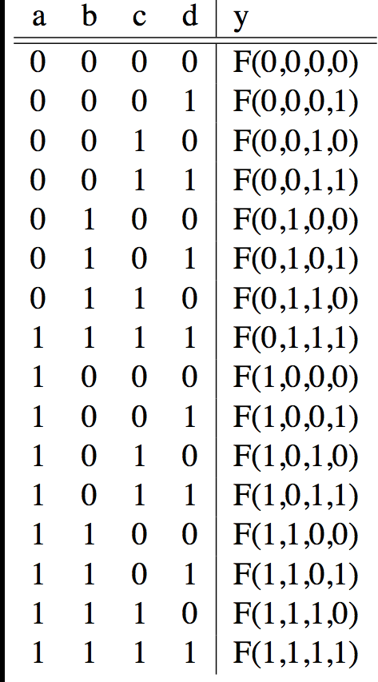
Truth Tables for Combinational Logic
A
F
B
Y
C
0
D
Exhaustive list of the output value generated for each combination of inputs

Slide 25
Truth Table Example #1: y= F(a,b): 1 iff a ≠ b
a | b | y
0 | 0 | 0
0 | 1 | 1
1 | 0 | 1
1 | 1 | 0
Y = A B + A B
Y = A + B
XOR

Slide 26
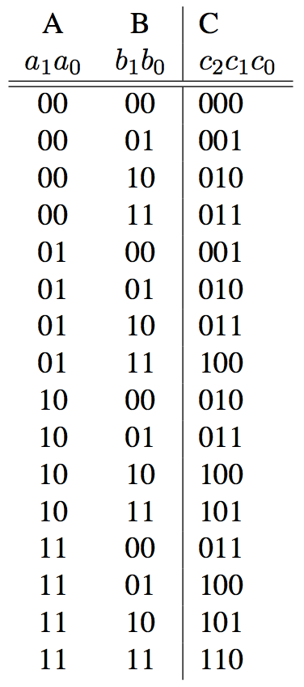
Truth Table Example #2: 2-bit Adder
How Many Rows?
A1
+
C2
A0
C1
B1
C0
B0

Slide 27
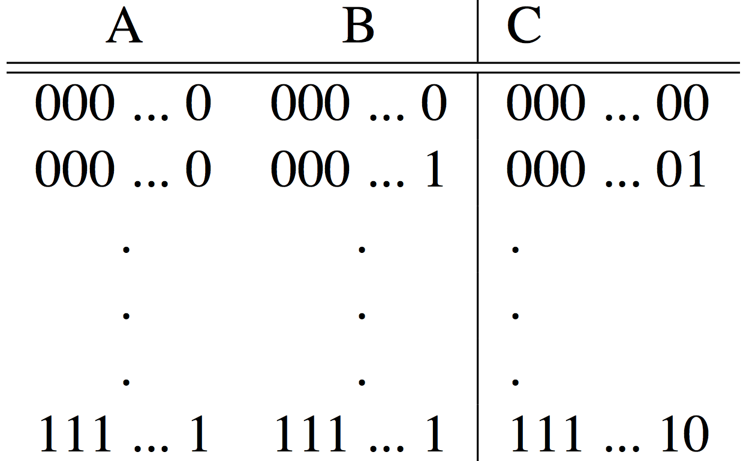
Truth Table Example #3: 32-bit Unsigned Adder
How Many Rows?

Slide 28
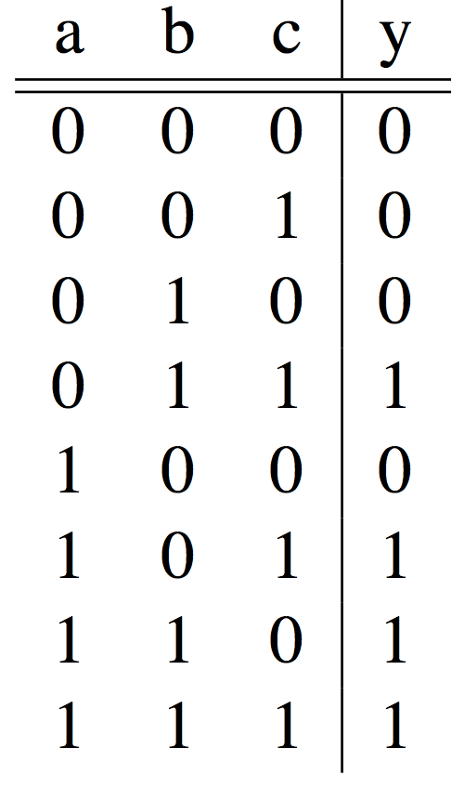
Truth Table Example #4: 3-input Majority Circuit
Y = A B C + A B C + A B C + A B C
This is called Sum of Products form;
Just another way to represent the TT as a logical expression
Y = B C + A (B C + B C)
Y = B C + A (B + C)
More simplified forms (fewer gates and wires)

Slide 29
Boolean Algebra
Use plus “+” for OR
“logical sum”
Use product for AND (a•b or implied via ab)
“logical product”
“Hat” to mean complement (NOT)
Thus
ab + a + c
= a•b + a + c
= (a AND b) OR a OR (NOT c )

Slide 30
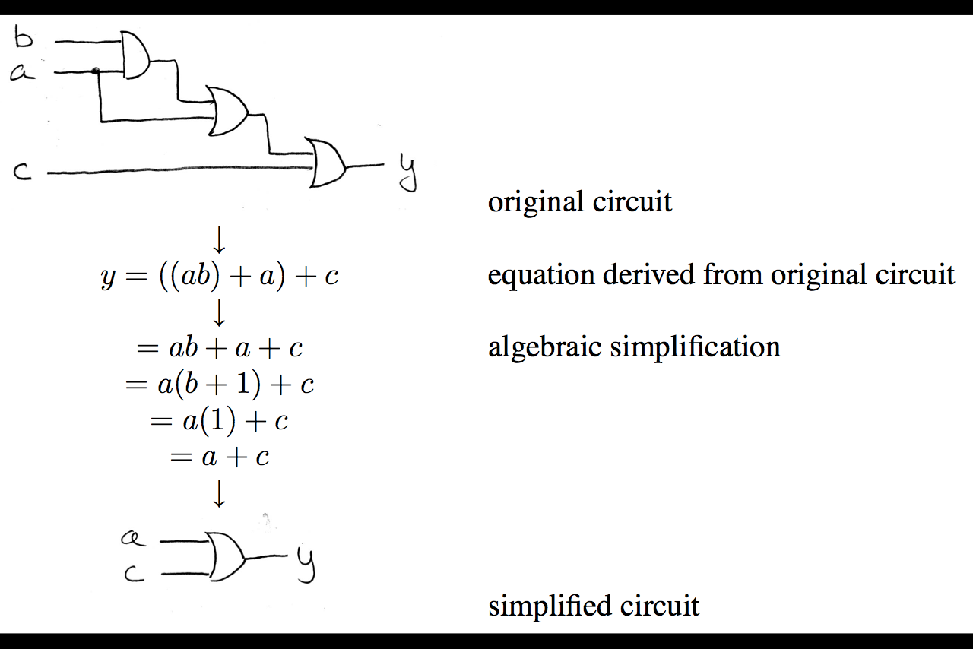
Boolean Algebra: Circuit & Algebraic Simplification

Slide 31
Laws of Boolean Algebra
X X = 0
X 0 = 0
X 1 = X
X X = X
X Y = Y X
(X Y) Z = Z (Y Z)
X (Y + Z) = X Y + X Z
X Y + X = X
X Y + X = X + Y
X Y = X + Y
X + X = 1
X + 1 = 1
X + 0 = X
X + X = X
X + Y = Y + X
(X + Y) + Z = Z + (Y + Z)
X + Y Z = (X + Y) (X + Z)
(X + Y) X = X
(X + Y) X = X Y
X + Y = X Y
Complementarity
Laws of 0’s and 1’s
Identities
Idempotent Laws
Commutativity
Associativity
Distribution
Uniting Theorem
United Theorem v. 2
DeMorgan’s Law

Slide 32
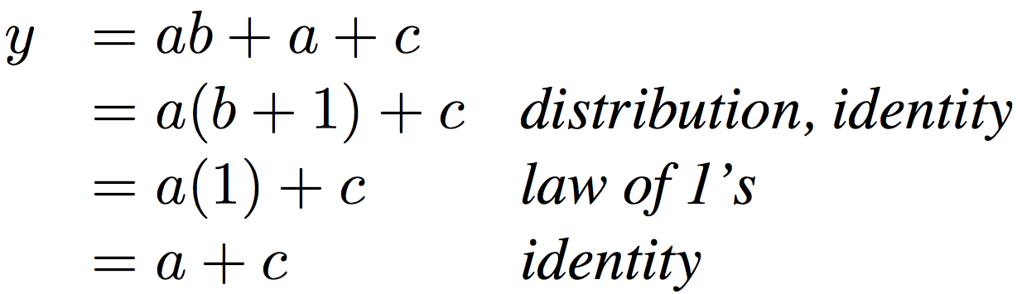
Boolean Algebraic Simplification Example
Notes:
Do on black board
First write truth table
Then minimize and check truth table
From distribution: a(b +1) + c
Froms laws of 0s and 1s: b+1 = 1
= a + c
Truth Table
a b c y
0 0 0 0
0 0 1 1
0 0 1 1

Slide 33
Boolean Algebraic Simplification Example
a b c y
0 0 0 0
0 0 1 1
0 1 0 0
0 1 1 1
1 0 0 1
1 0 1 1
1 1 0 1
1 1 1 1
Notes:
Do on black board
From distribution: a(b +1) + c
Froms laws of 0s and 1s: b+1 = 1
= a + c
Truth Table
a b c y
0 0 0 0
0 0 1 1
0 1 0 0
0 1 1 1
1 0 0 1
1 0 1 1
1 1 0 1
1 1 1 1

Slide 34
Clickers/Peer Instruction
Simplify Z = A+BC + A•(BC)
A: Z = 0
B: Z = A(1+ BC)
C: Z = (A + BC)
D: Z = BC
E: Z = 1
Notes:
Top
X = 0v Y = 0V both closed on top, so Z = 3v
X = 0v Y = 0V both open bottom
X = 0v Y = 3V 2nd closed on top, so Z = 3v
X = 0v Y = 3V 2nd in series open
X = 3v Y = 0V 1st closed on top, so Z = 3v
X = 3v Y = 0V 1st in series open
X = 3v Y = 3V both open on top
X = 3v Y = 0V both closed, so Z = 0v

Slide 35
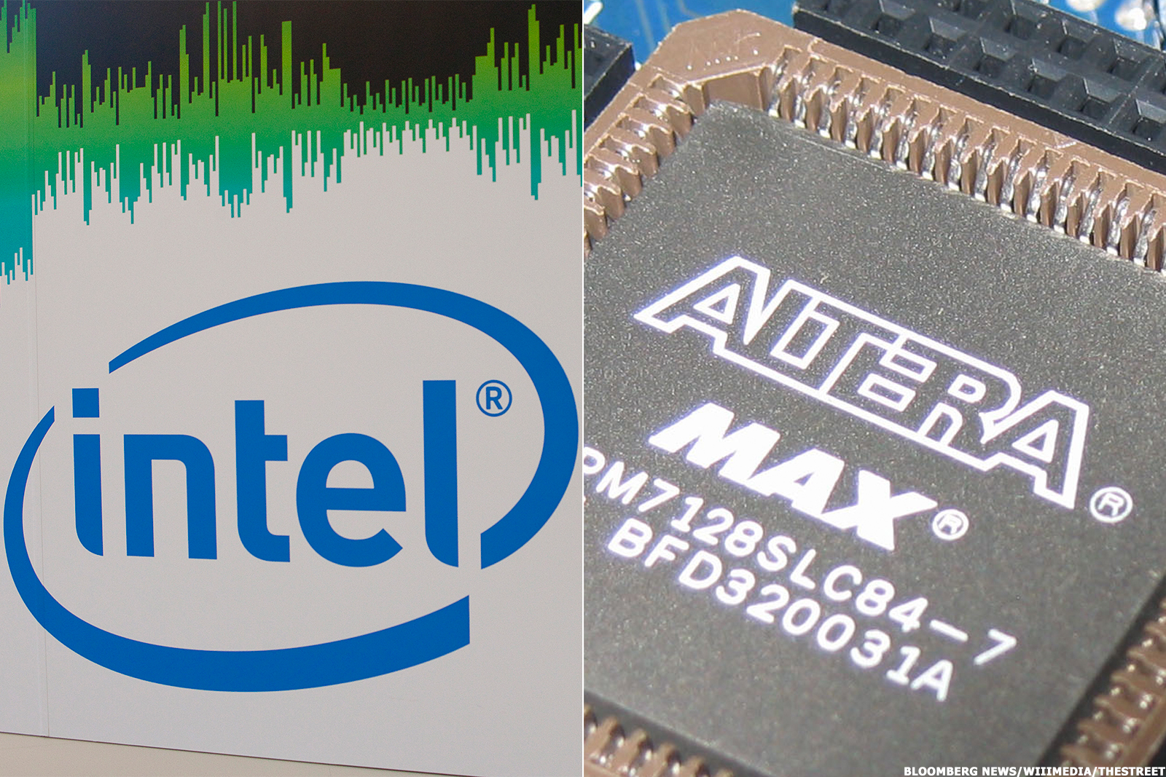
In the News: Intel buys Altera
Intel purchased Altera, an FPGA (Field Programmable Gate Array) company for 16.7 billion
Goal is to place reconfigurable hardware on Intel server chips
Take CS150 to learn how to program FPGAs

Slide 36
Break
(Maybe)

Slide 37
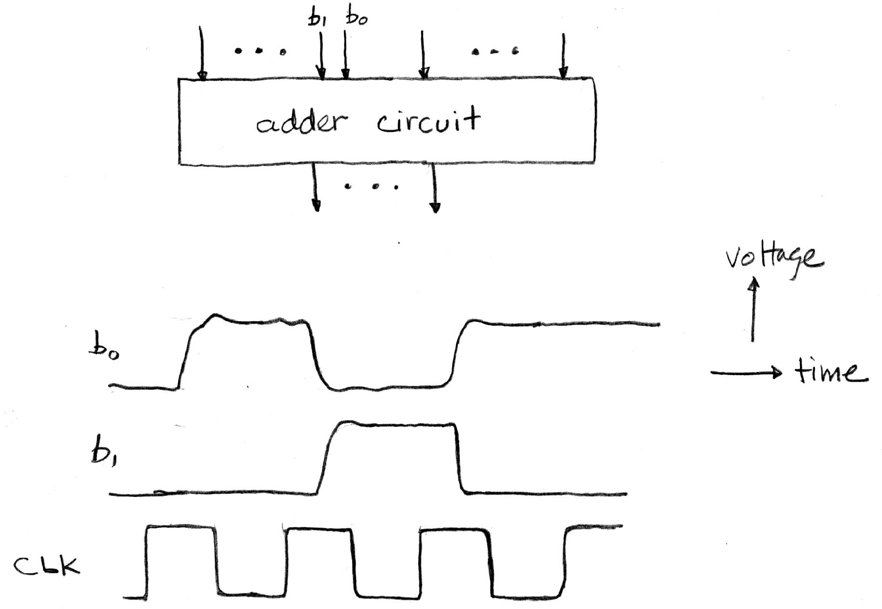
Signals and Waveforms
a_{n-1}
a_{n-1}
a₀
Delay!
Noisy!

Slide 38
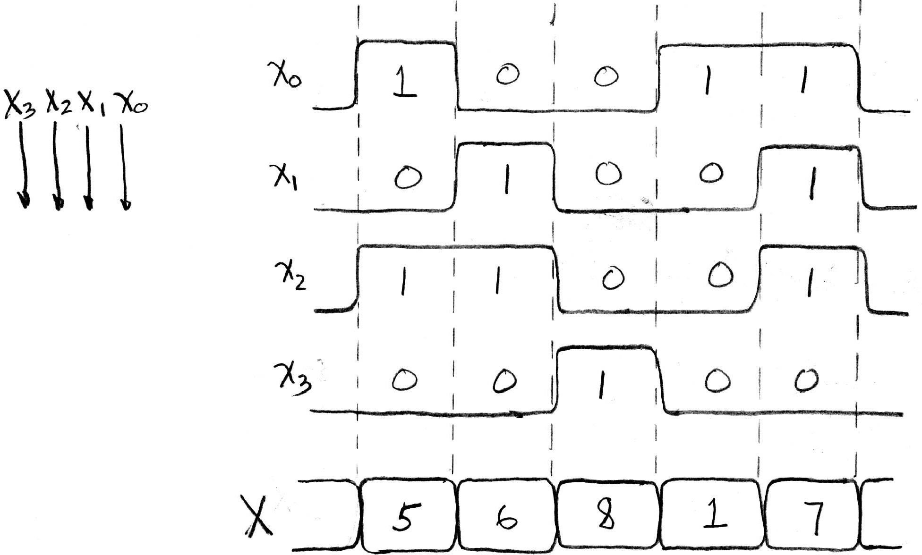
Signals and Waveforms: Grouping

Slide 39
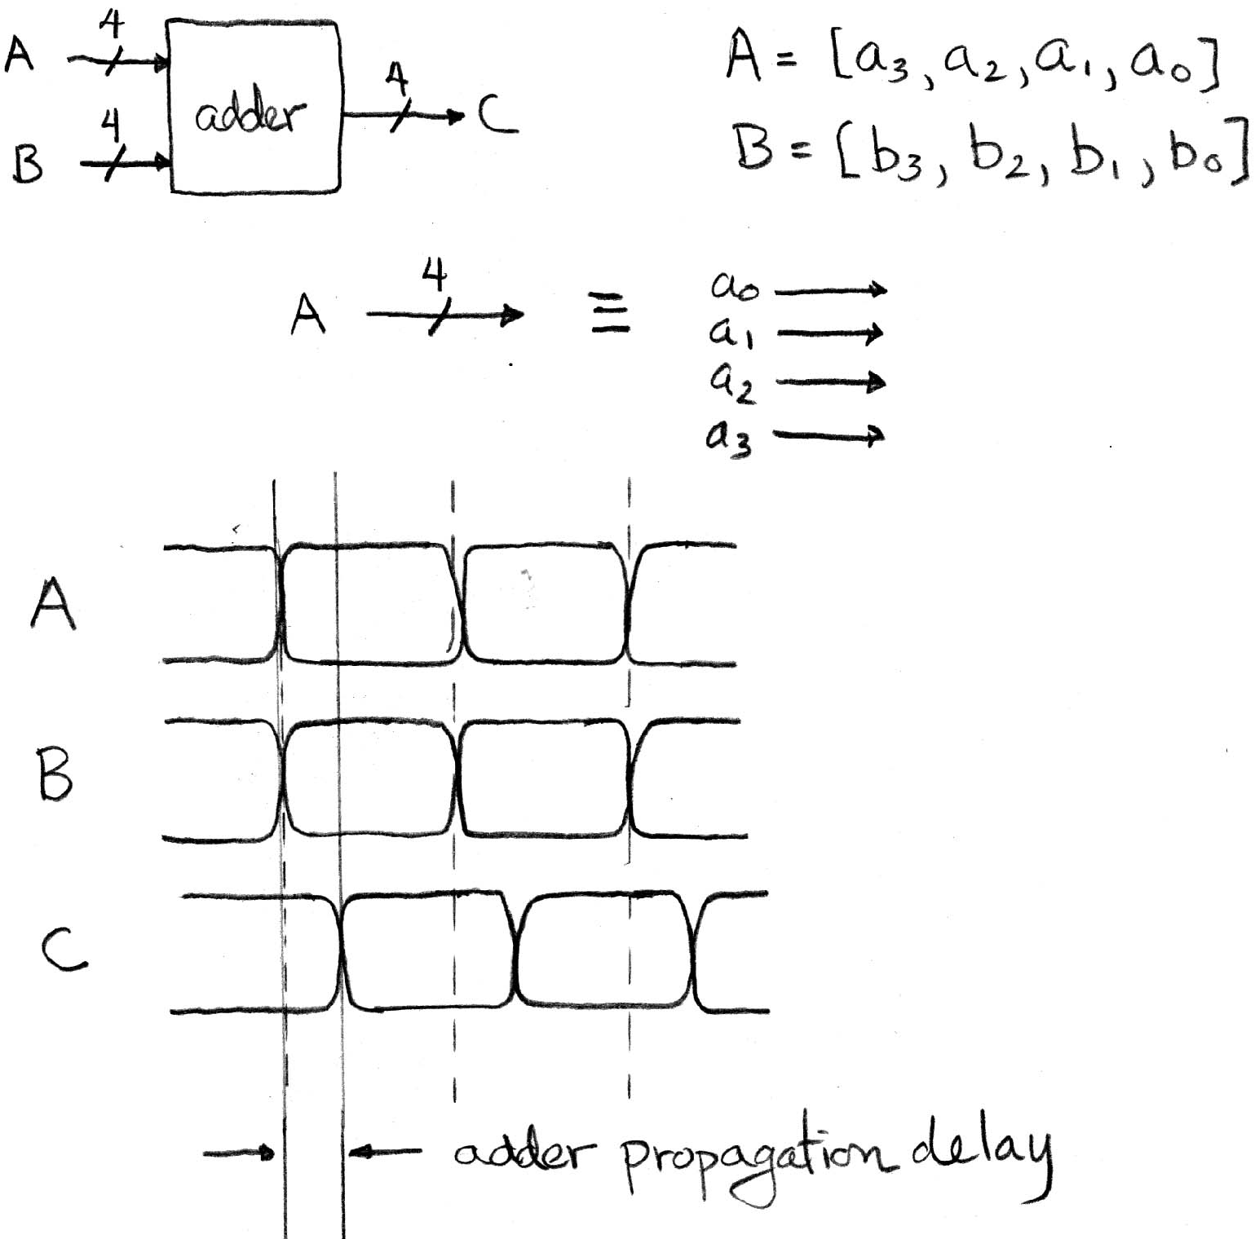
Signals and Waveforms: Circuit Delay
2
3
4
5
3
10
0
1
5
13
4
6

Slide 40
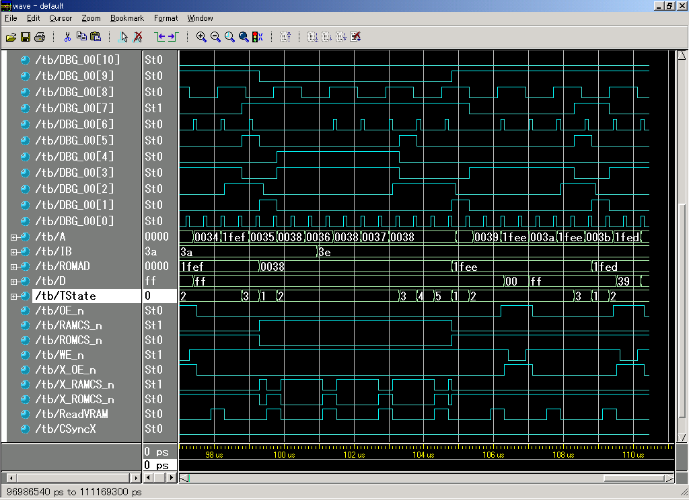
Sample Debugging Waveform

Slide 41
Type of Circuits
Synchronous Digital Systems consist of two basic types of circuits:
Combinational Logic (CL) circuits
Output is a function of the inputs only, not the history of its execution
E.g., circuits to add A, B (ALUs)
Sequential Logic (SL)
Circuits that “remember” or store information
aka “State Elements”
E.g., memories and registers (Registers)

Slide 42
Uses for State Elements
Place to store values for later re-use:
Register files (like $1-$31 in MIPS)
Memory (caches and main memory)
Help control flow of information between combinational logic blocks
State elements hold up the movement of information at input to combinational logic blocks to allow for orderly passage

Slide 43
Accumulator Example
Why do we need to control the flow of information?
SUM
X_{i}
S
Want: S=0;
for (i=0;i<n;i++)
S = S + X_{i}
Assume:
Each X value is applied in succession, one per cycle
After n cycles the sum is present on S

Slide 44
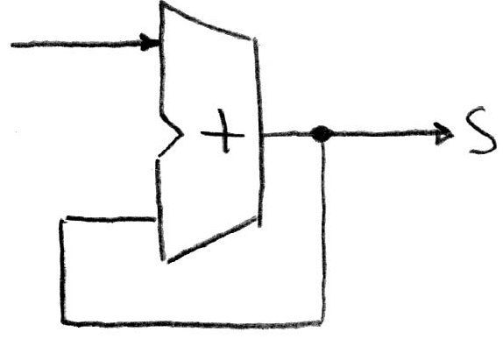
First Try: Does this work?
Feedback
No!
Reason #1: How to control the next iteration of the ‘for’ loop?
Reason #2: How do we say: ‘S=0’?

Slide 45
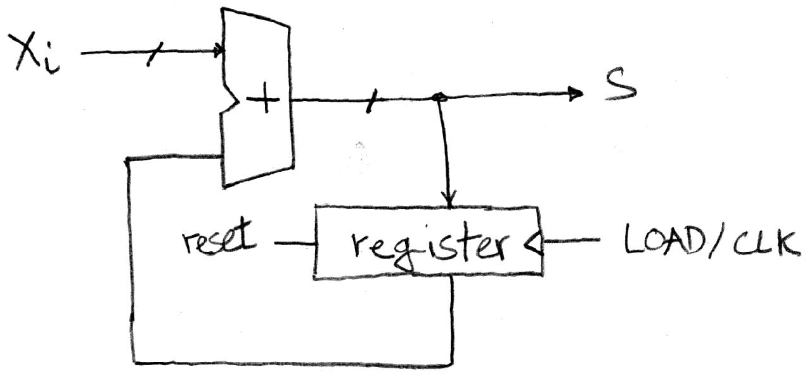
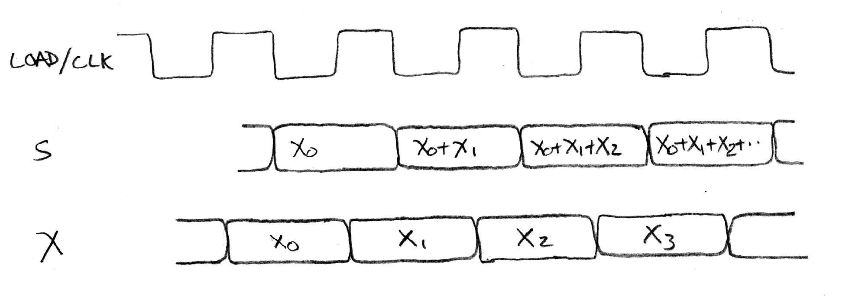
Second Try: How About This?
Register is used to hold up the transfer of data to adder
Square wave clock sets when things change
High (1)
Low (0)
Rough timing …
Rounded Rectangle per clock means could be 1 or 0
High (1)
Low (0)
Xi must be ready before clock edge due to adder delay
High (1)
Low (0)
Time

Slide 46
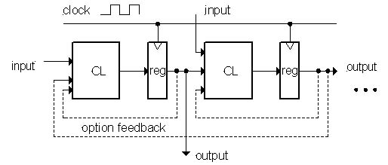
Model for Synchronous Systems
Collection of Combinational Logic blocks separated by registers
Feedback is optional
Clock signal(s) connects only to clock input of registers
Clock (CLK): steady square wave that synchronizes the system
Register: several bits of state that samples on rising edge of CLK (positive edge-triggered) or falling edge (negative edge-triggered)

Slide 47
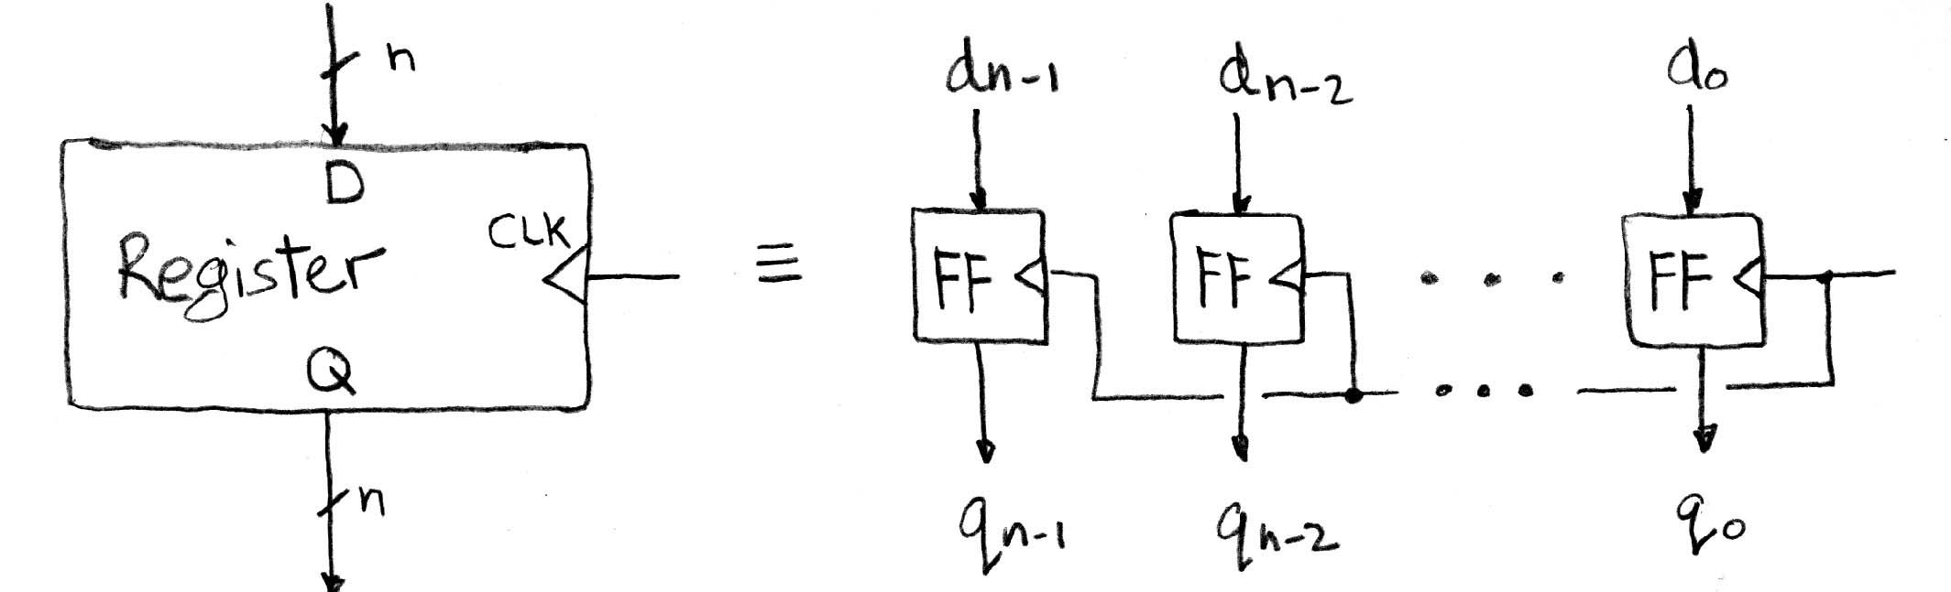
Register Internals
n instances of a “Flip-Flop”
Flip-flop name because the output flips and flops between 0 and 1
D is “data input”, Q is “data output”
Also called “D-type Flip-Flop”

Slide 48
Camera Analogy Timing Terms
Want to take a portrait – timing right before and after taking picture
Set up time – don’t move since about to take picture (open camera shutter)
Hold time – need to hold still after shutter opens until camera shutter closes
Time click to data – time from open shutter until can see image on output (viewscreen)

Slide 49
Hardware Timing Terms
Setup Time: when the input must be stable before the edge of the CLK
Hold Time: when the input must be stable after the edge of the CLK
“CLK-to-Q” Delay: how long it takes the output to change, measured from the edge of the CLK

Slide 50
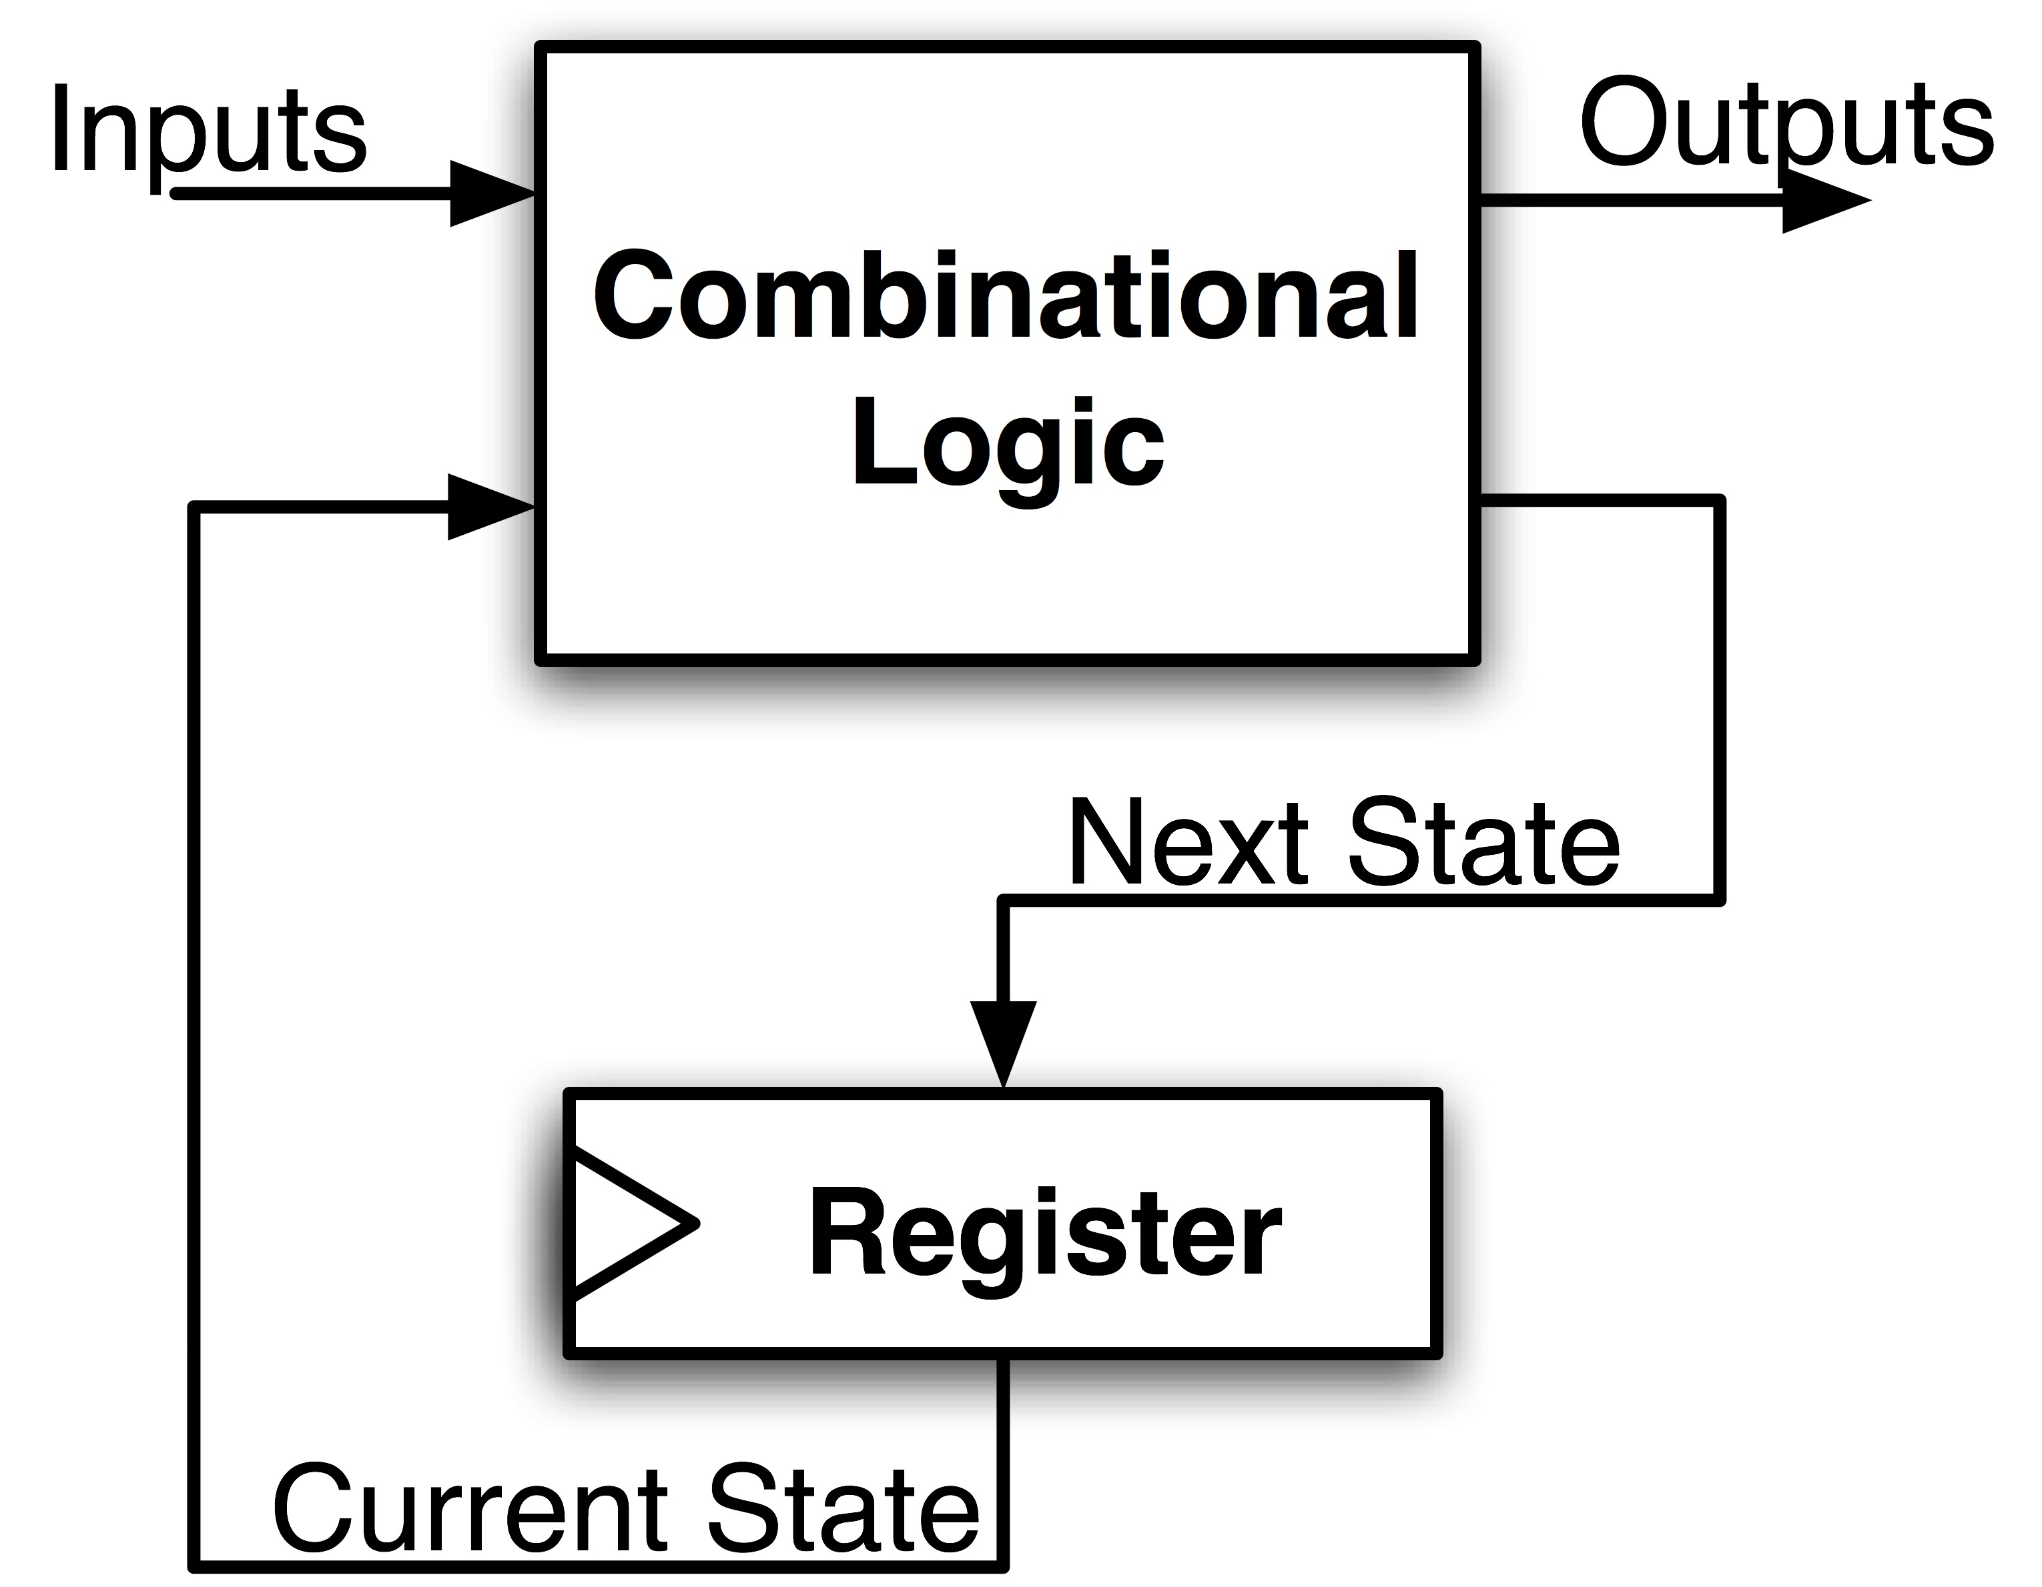
Maximum Clock Frequency
What is the maximum frequency of this circuit?
Hint:
Frequency = 1/Period
Max Delay = Setup Time + CLK-to-Q Delay + CL Delay

Slide 51
And in Conclusion, …
Multiple Hardware Representations
Analog voltages quantized to represent logic 0 and logic 1
Transistor switches form gates: AND, OR, NOT, NAND, NOR
Truth table mapped to gates for combinational logic design
Boolean algebra for gate minimization
State Machines
Finite State Machines: made from Stateless combinational logic and Stateful “Memory” Logic (aka Registers)
Clocks synchronize D-FF change (Setup and Hold times important!)
More about these next time

